Slide 1
Other Inputs
Neighbourhood effect
Logistic curve parameters
Payback Period Calculations
PV associated costs
Utility Prices
Inputs
Building Geometries
Building Properties (age, architecture, occupancy etc.)
CEA Model
Alt-Wiedikon, Zurich
(Sabine Python)
CEA Output Data Processing
ABM (Muaafa et. al)
Data Visualisation
Excel + GIS
Additions for Community PV adoption
Building locations and types
Electricity demand profiles
Solar PV Profiles
Adoption Rates, building types and locations: Individual v Community scenarios
Electricity Prices in each scenario

Slide 2
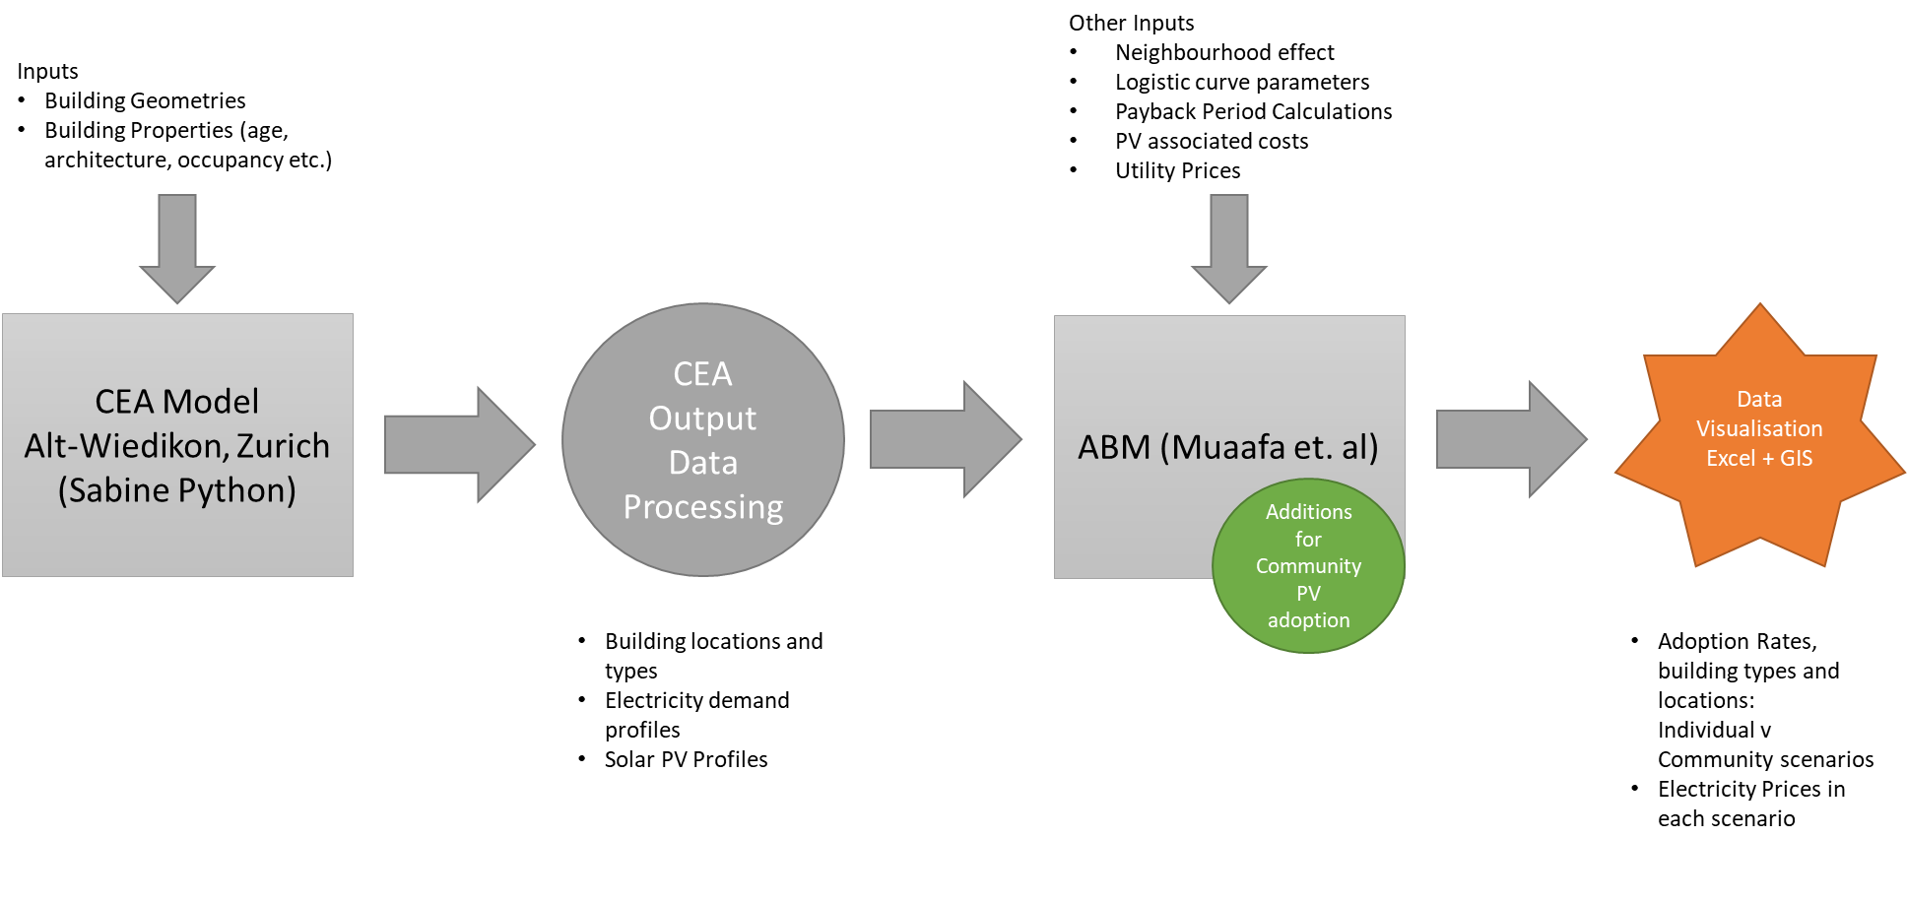

Slide 3
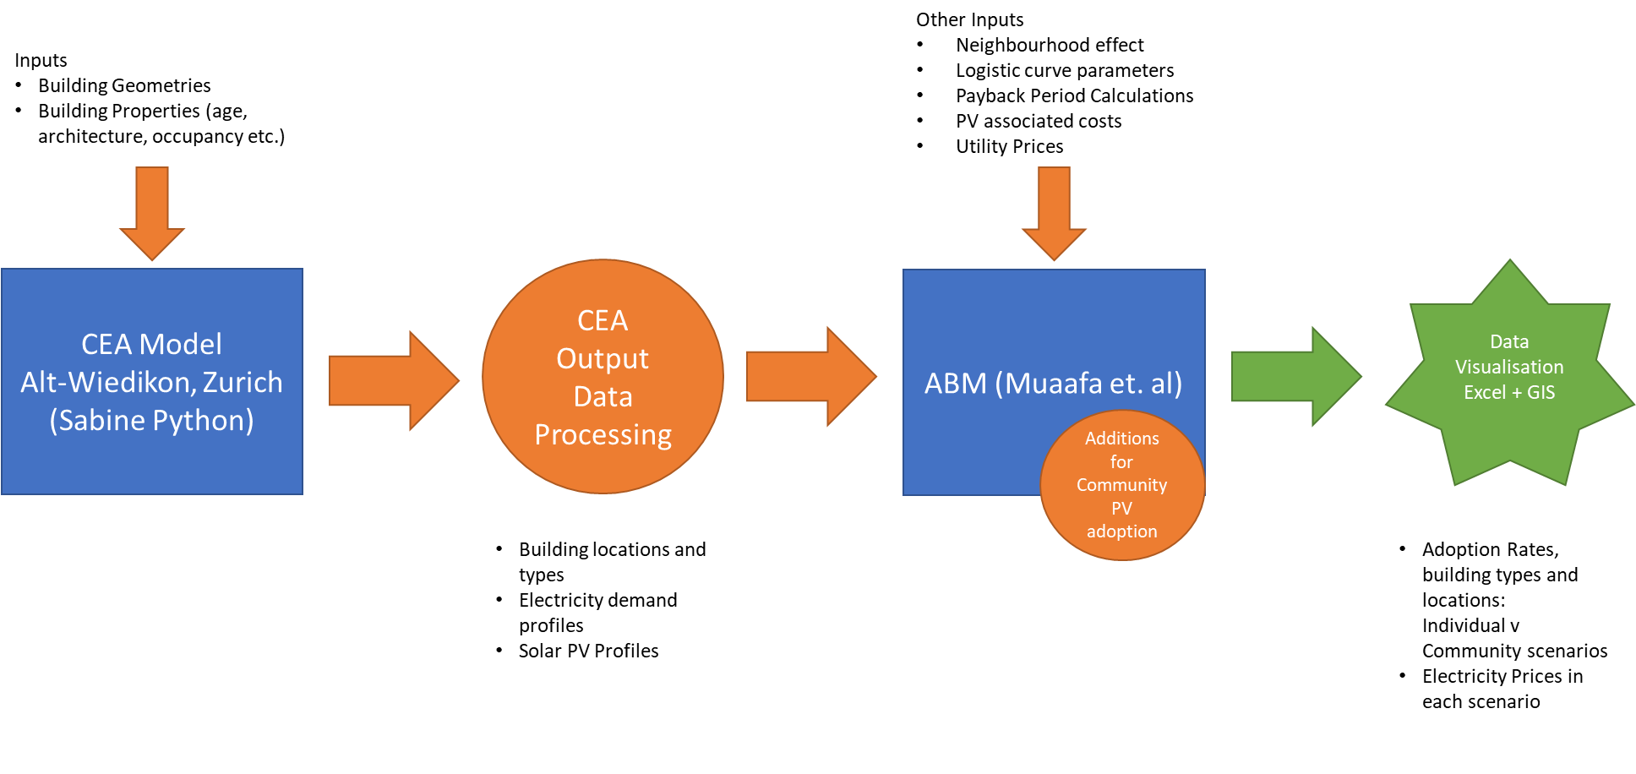

Slide 4
ABM
Individuals
ABM
Community

Slide 5
Scenarios | ABM Individual | ABM Community
FiT level X, Remuneration Y%, Ownership of PV | A1 % PV Adoption P1 % Elec Tariff Change | A2 % PV Adoption P2 % Elec Tariff Change
FiT level XX, Remuneration YY%, Third Party Ownership of PV | A3 % PV Adoption P3 % Elec Tariff Change DEATH SPIRAL LIKELY! | A4 % PV Adoption P4 % Elec Tariff Change
… | … | …

